Slide 1
Slides for screencast

Slide 2


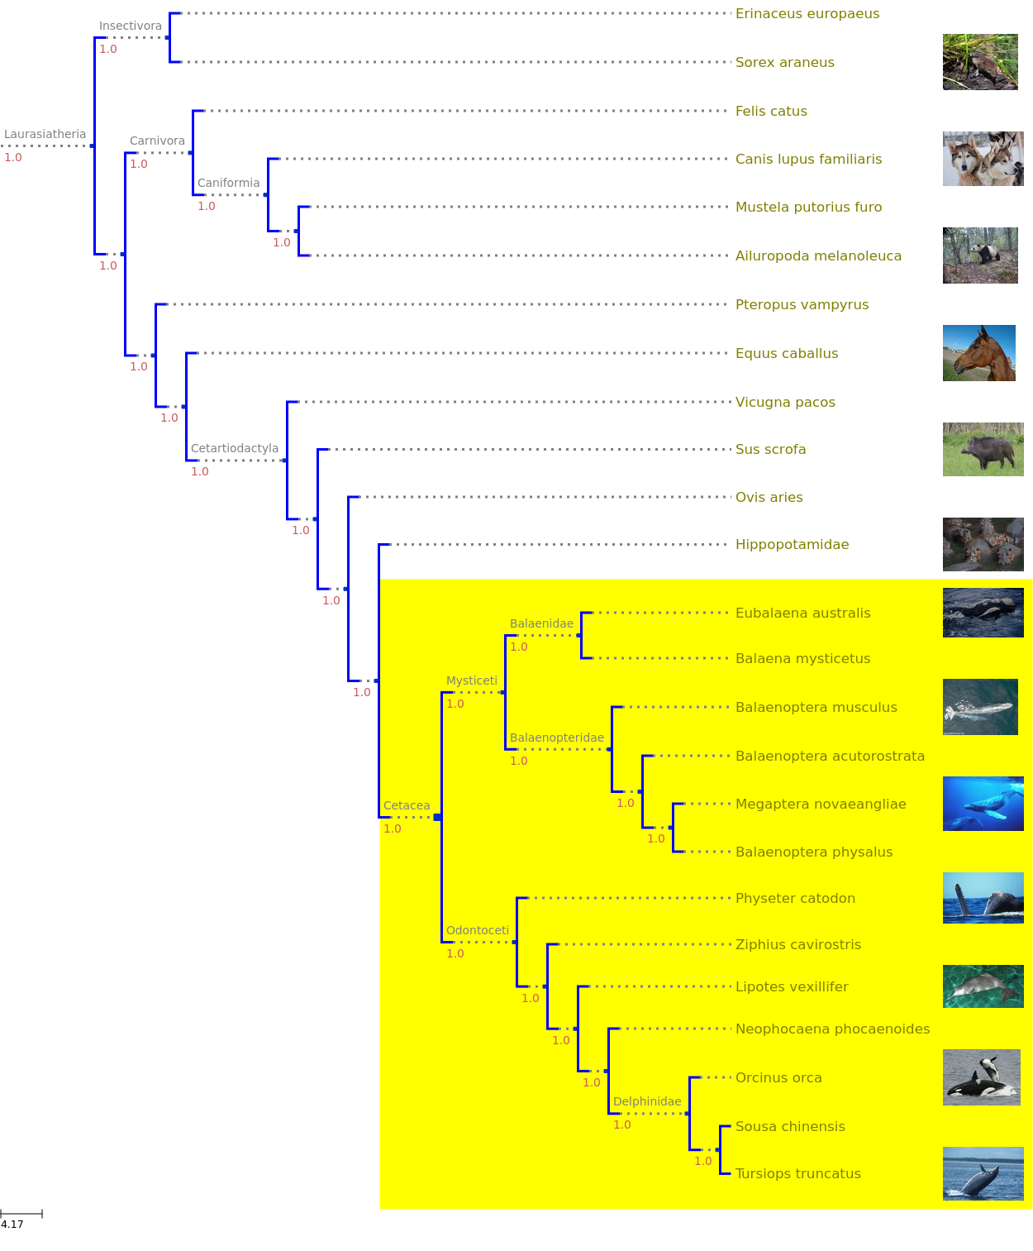




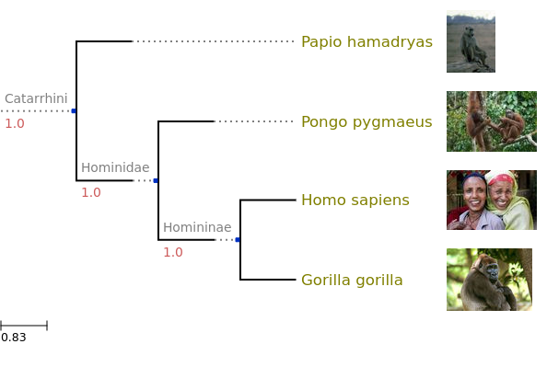
workflow #1
Extract names
Manage list
Get tree

Slide 3
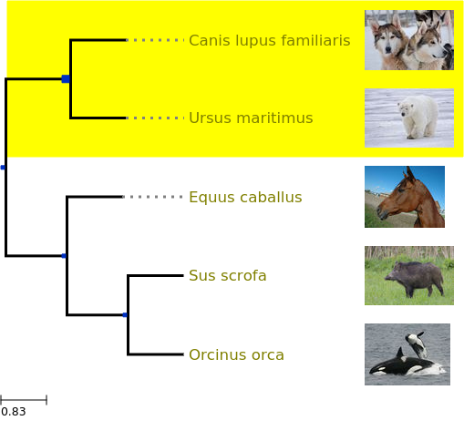
workflow #1
Get names
Manage list
View tree
scrape
upload
choose
Cetacea
Felidae
Passerina

Slide 4
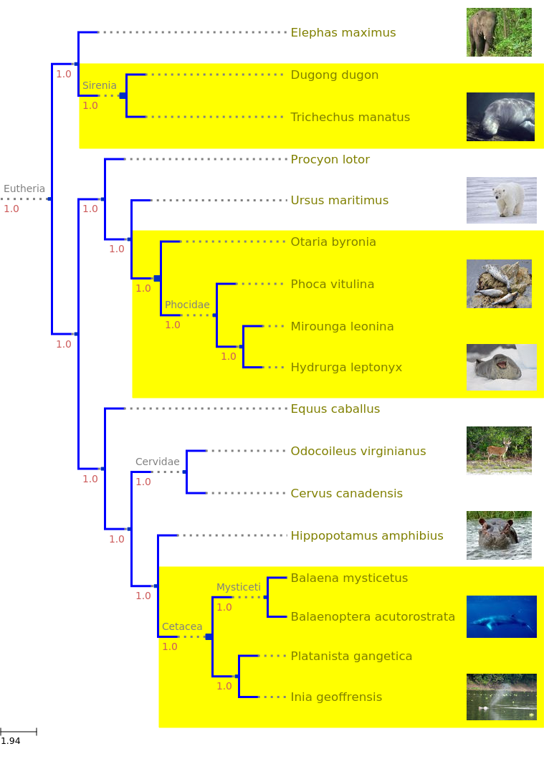

workflow #2
Parse file
Manage list
Get tree
ZIP
DwC-A

Slide 5
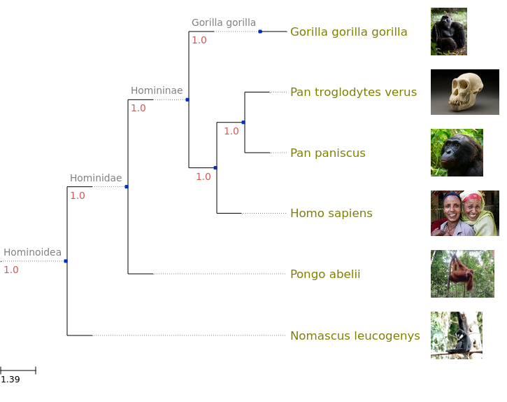
workflow #3
Pick sample
Manage list
Get tree
Carnivora
Cetacea
Hominoidea
. . .
has NCBI genome
found in country X
random sample

Slide 6
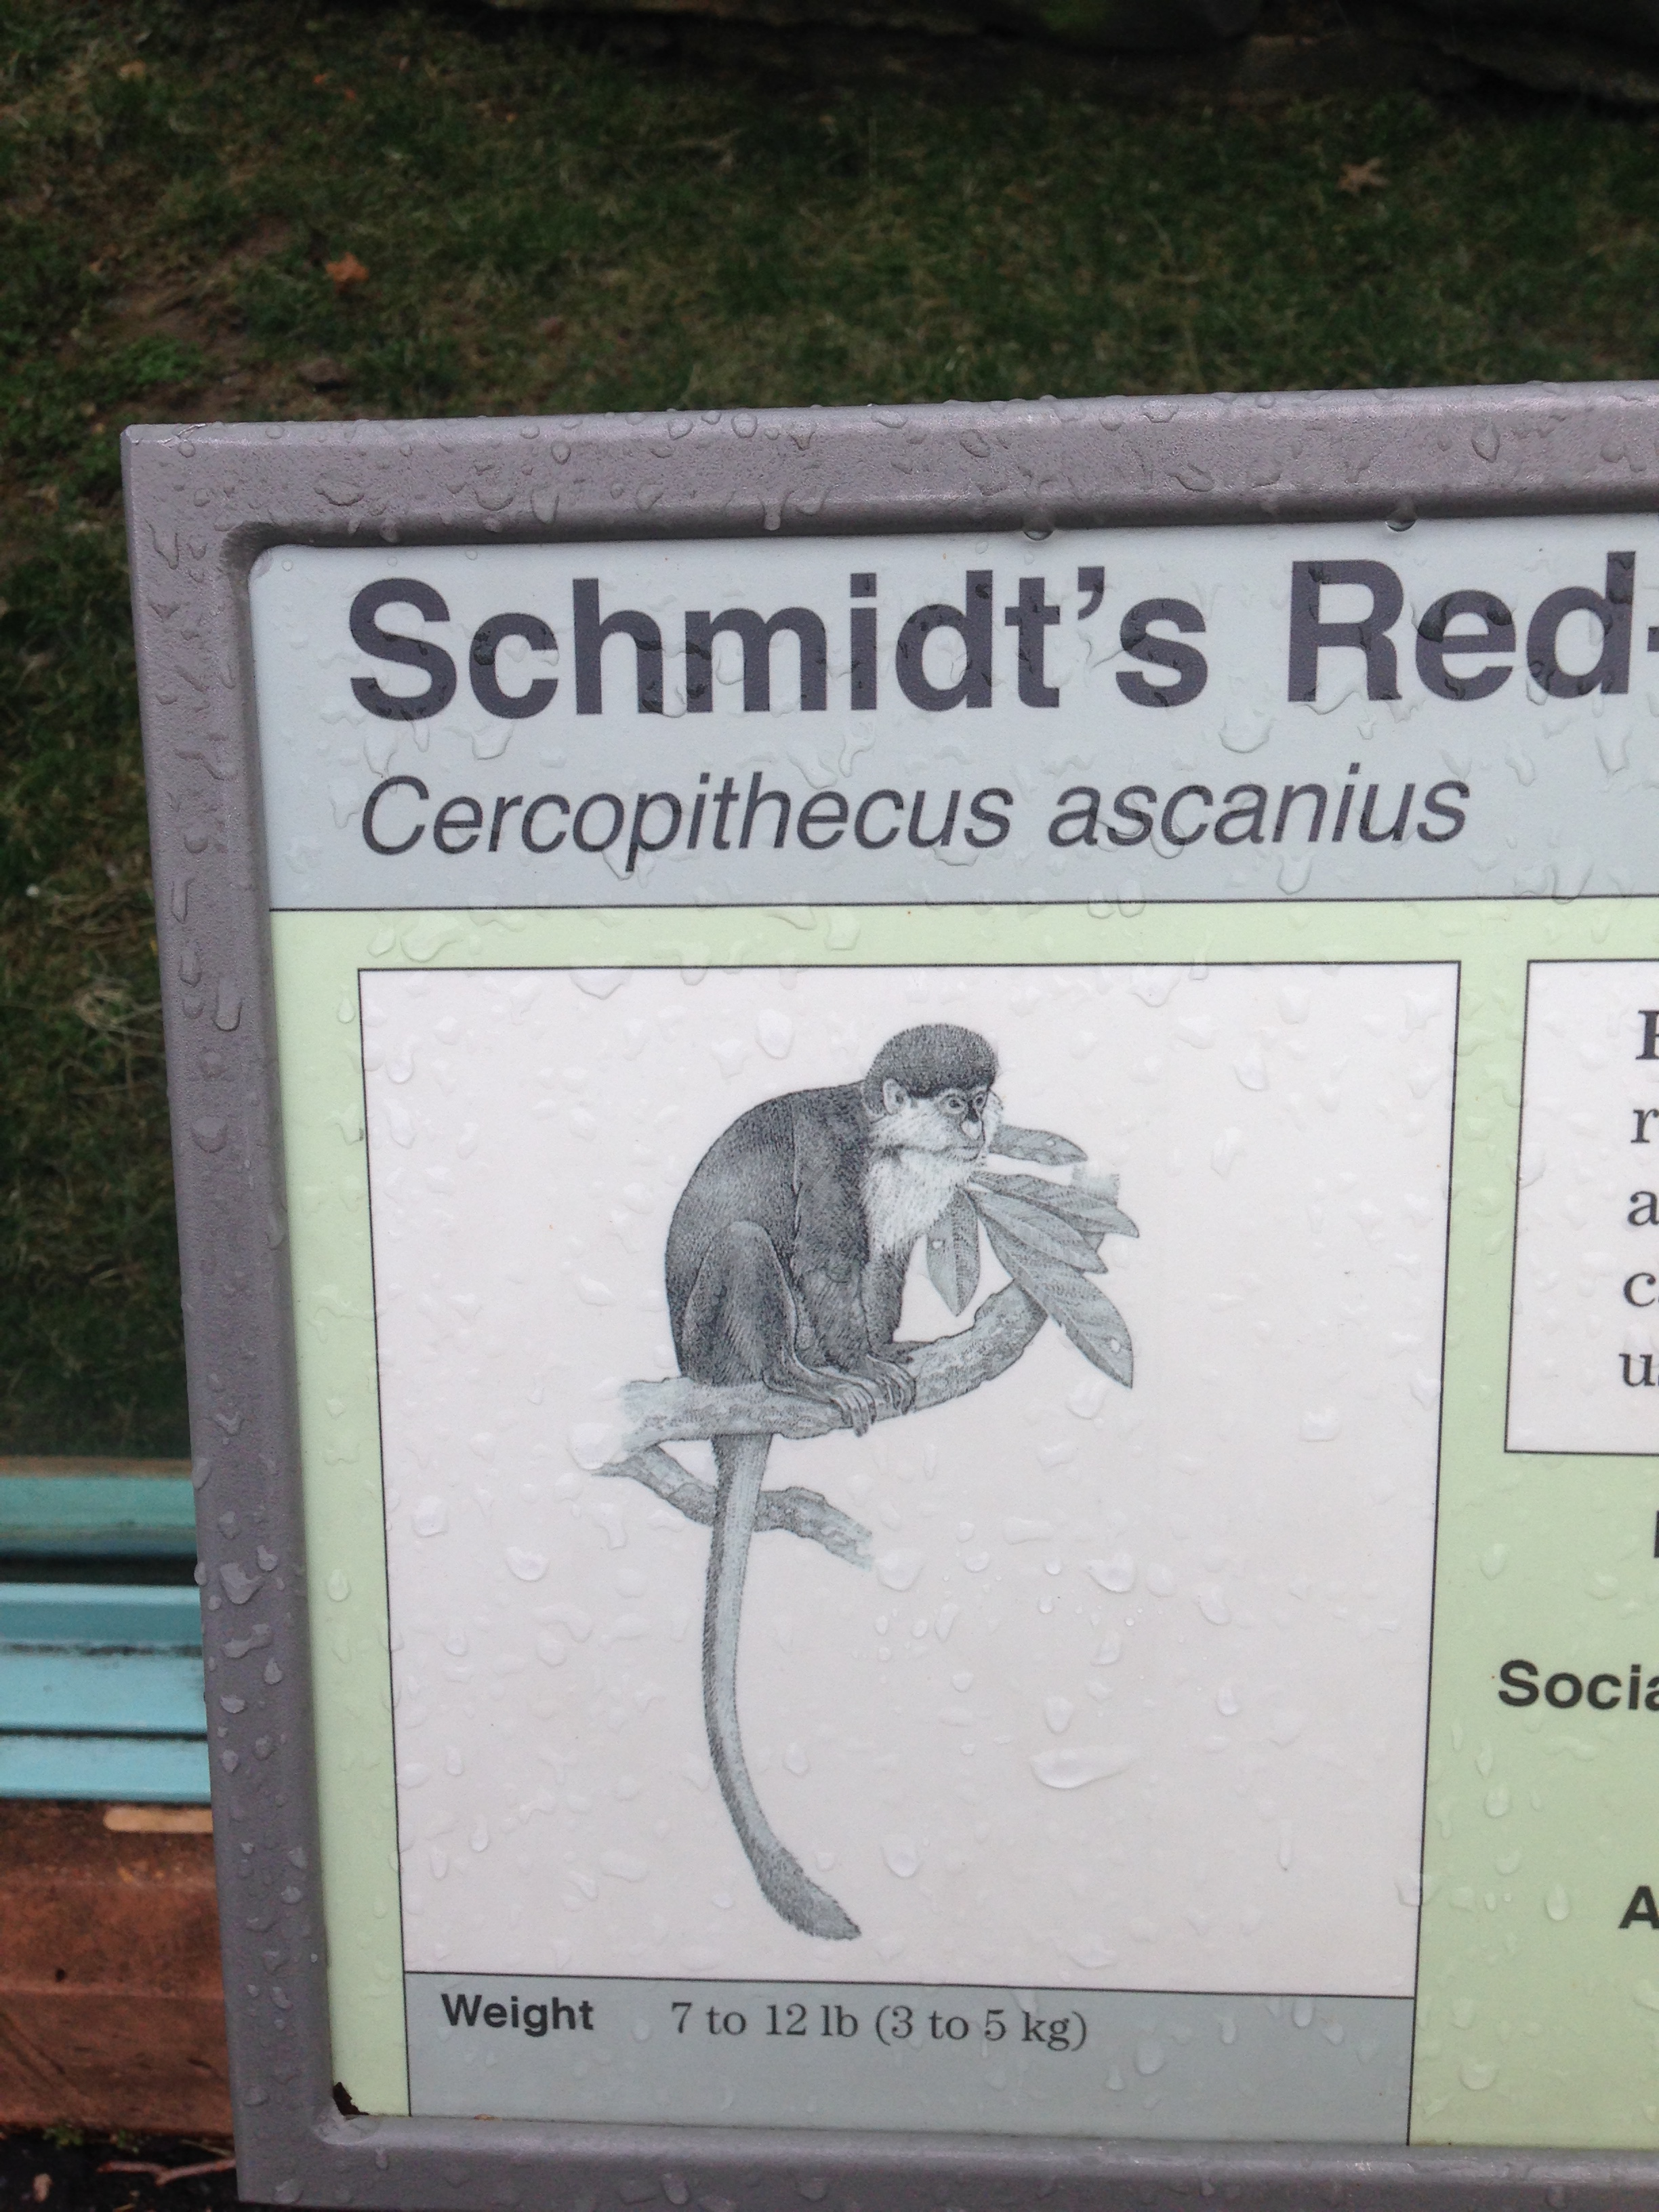
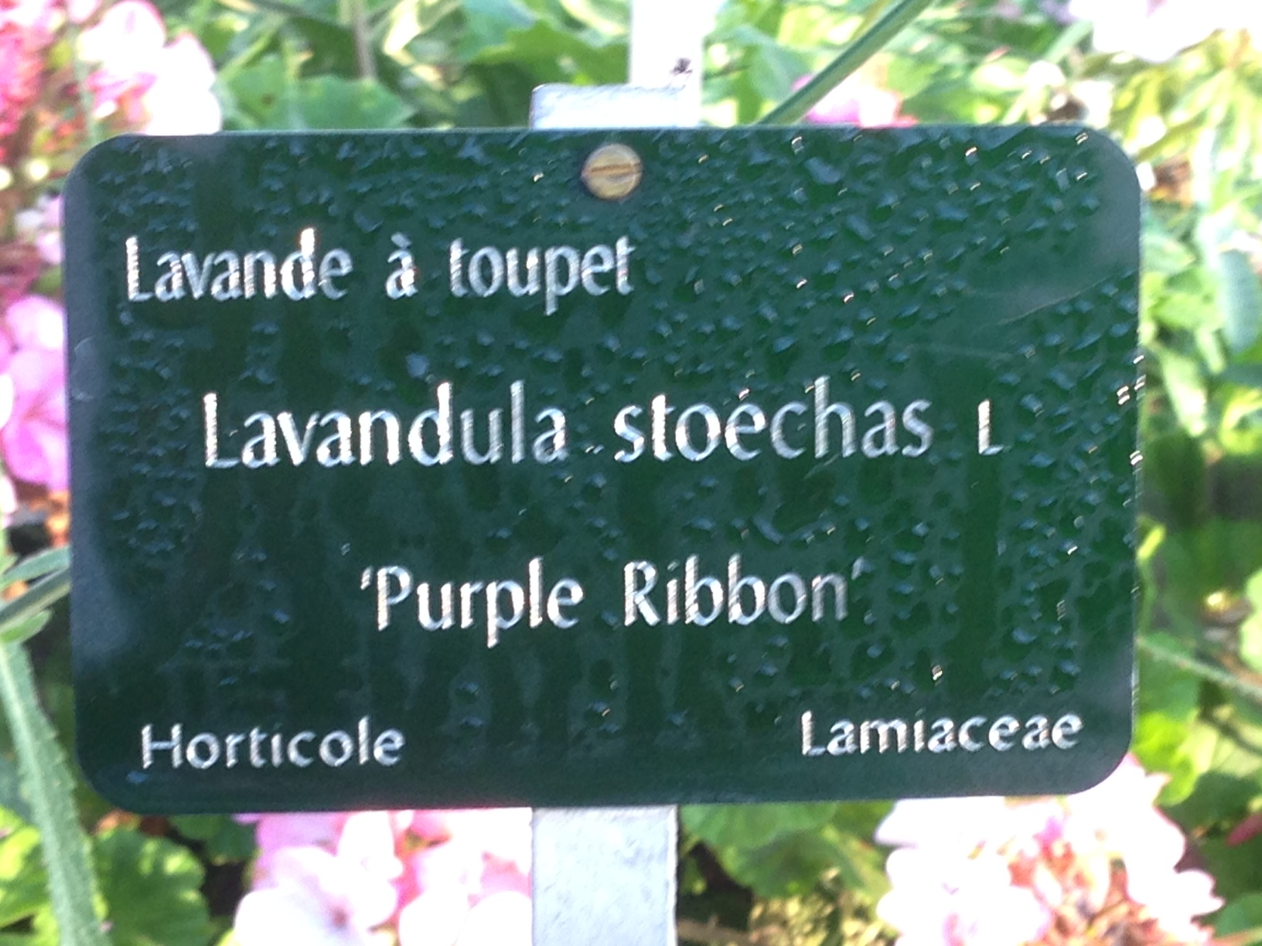
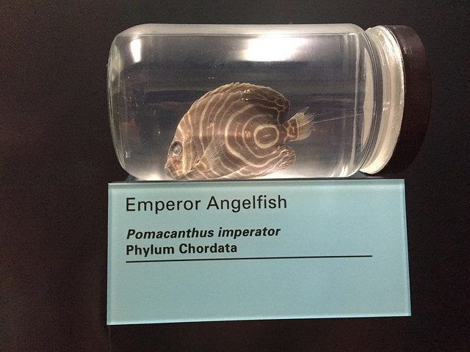
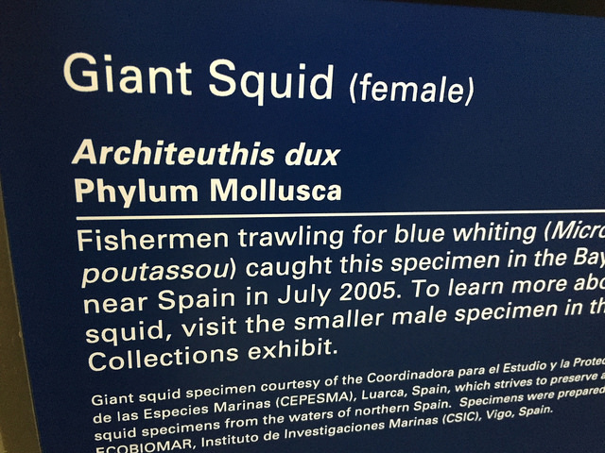
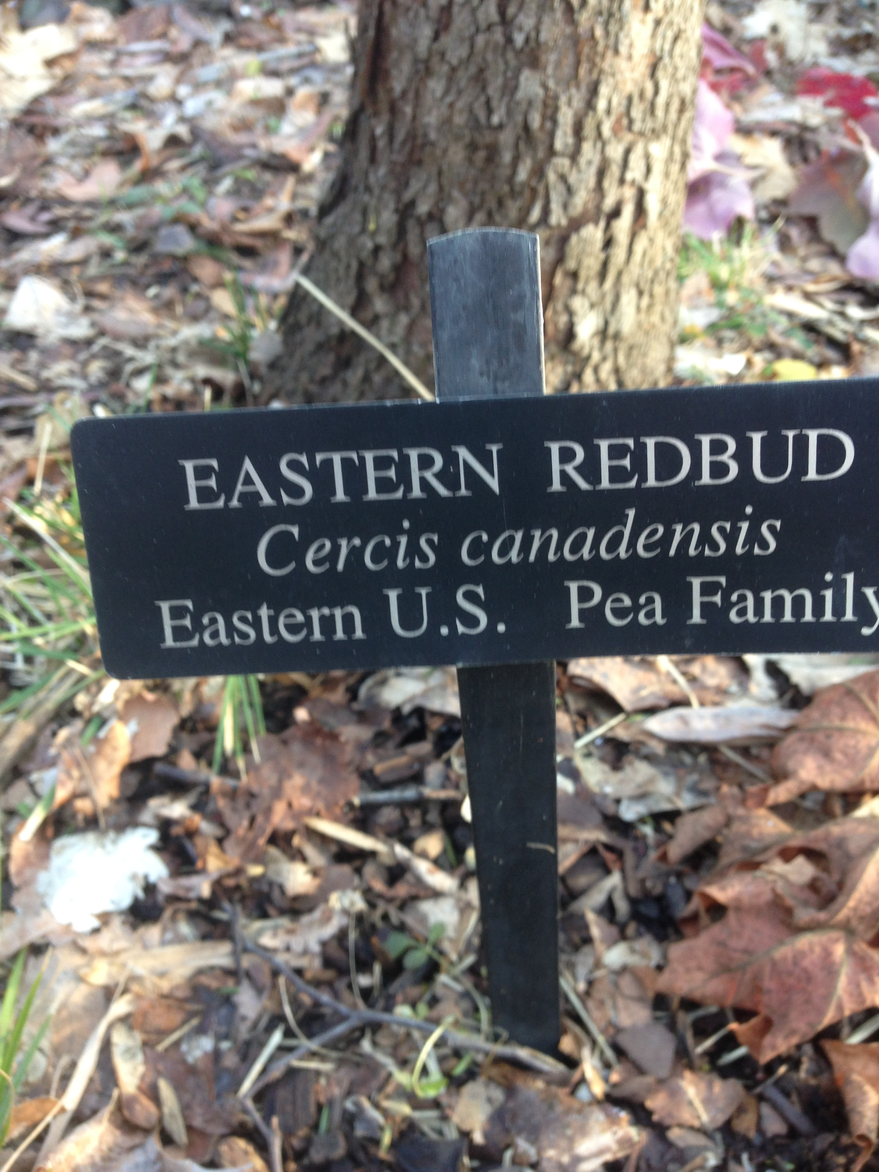
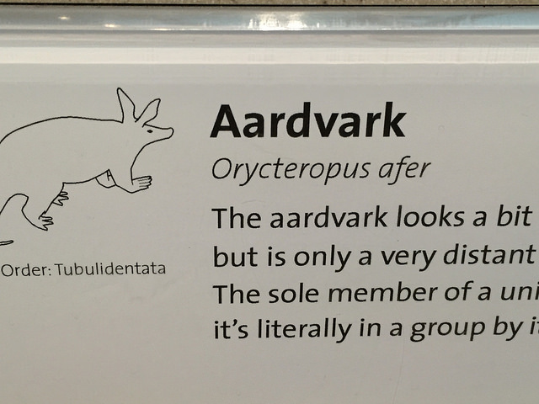
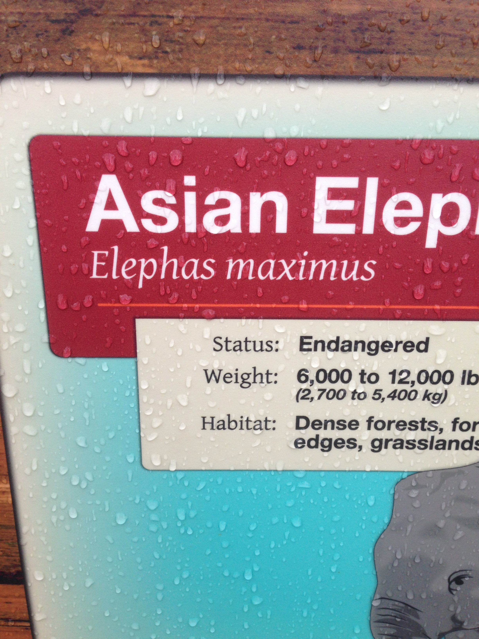
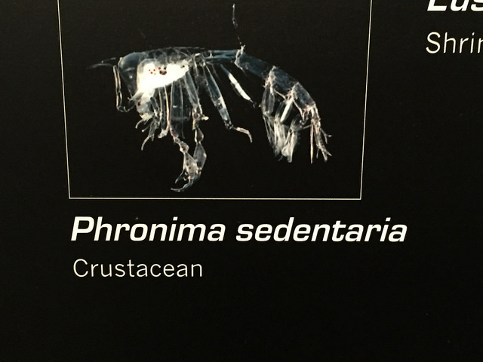
Mobile app
Capture names from signs
Manage list
Get tree
National Zoo, DC
Jardin des Plantes, Paris
Smithsonian MNH, DC
Longwood Gardens, PA

Slide 7
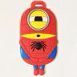












Phylotastic.org
ducvan0212
abusalehmdtayeen
dimus
epontell
thanhnh-infinity
lunasare
hdliv
bomeara
arlin

